Slide 1

The international Partnership Initiative to promote Evaluation Capacity Development

Slide 2
EvalPartners: Why now?
Recognition of significant growth and existing expertise
From Paris “Declaration on Aid effectiveness” to Busan “Partnership for effective development cooperation”
The role of Civil society organizations (CSO) in National Evaluation Systems
An initiative to strengthen equity-focused and gender-responsive Country-led Evaluation Systems through wider partnership and use of innovation

Slide 3
EvalPartners: What?
Strengthen institutional capacity
Raise the visibility, role and influence in countries
Build evaluation capacity of VOPE members
Equity-focused and Gender-responsive evaluation systems/policies

Slide 4
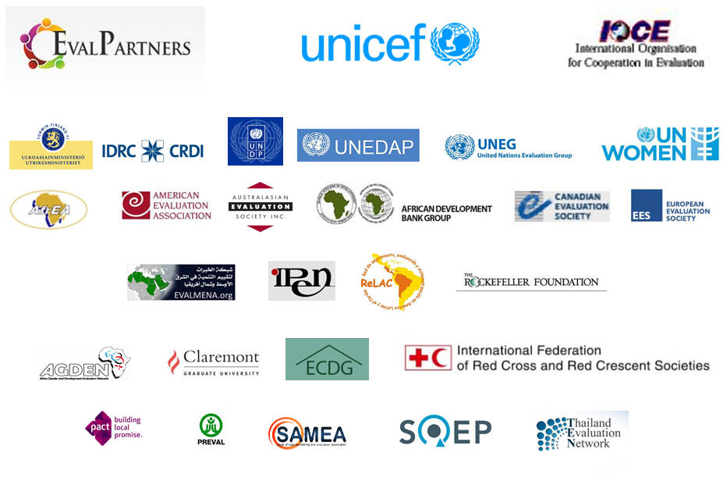


An international collaborative initiative with 29+ key partners and others still joining

Slide 5
EvalPartners
Guiding Principles
Strategic Partnership
Innovation
Inclusion

Slide 6
EvalPartners
GOVERNANCE Structure
International Advisory Group
Role: Provide guidance and recommendations on the conceptualization and implementation of the initiative
Management Group
Role: Ensure implementation proceeds according to the plans.
UNICEF, IOCE, and other partners

Slide 7
Purpose of the EvalPartners Initiative
To promote collaboration among evaluation organizations (VOPEs) to strengthen Evaluation Capacity Development … including addressing the evaluation environment, i.e. policies, systems, demand for and use of evaluations.

Slide 8
What’s a VOPE?
Voluntary Organization for Professional Evaluation
I.e. formal associations or societies; informal networks / communities of practice … open to a wide variety of members

Slide 9

Mapping the status of VOPEs around the world

Slide 10
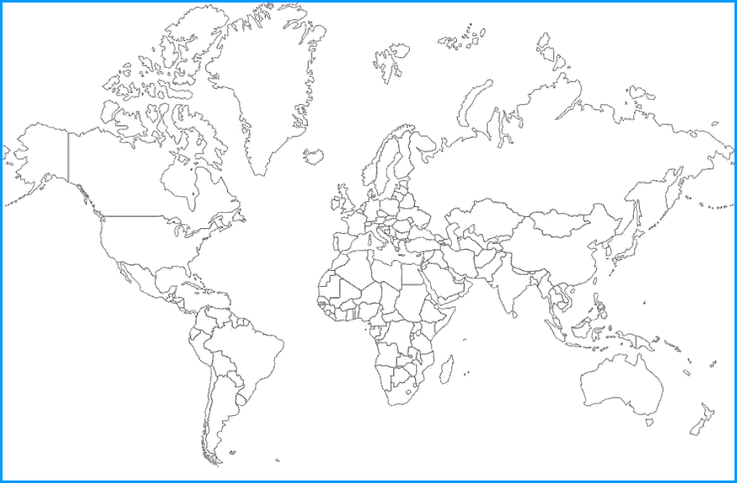
1981 Canadian Evaluation Society (CES)
Societe canadienne d'evaluation (SCE)

Slide 11
1986 – American Evaluation Association (AEA)
merger of Evaluation Research Society (1979) and Evaluation Network (1982)

Slide 12
1987 – Australasian Evaluation Society (AES)

Slide 13
1992 – UK Evaluation Society (UKES)

Slide 14
1994 – European Evaluation Society (EES)

Slide 15
1999 – African Evaluation Association (AfrEA)

Slide 16
2000 – International Program Evaluation Network (IPEN)

Slide 17
2004 – ReLAC (Red de Seguimiento, Evaluación y Sistematización en America Latina y el Caribe)

Slide 18
2008 – Community of Evaluators South Asia (CoE/SA)

Slide 19
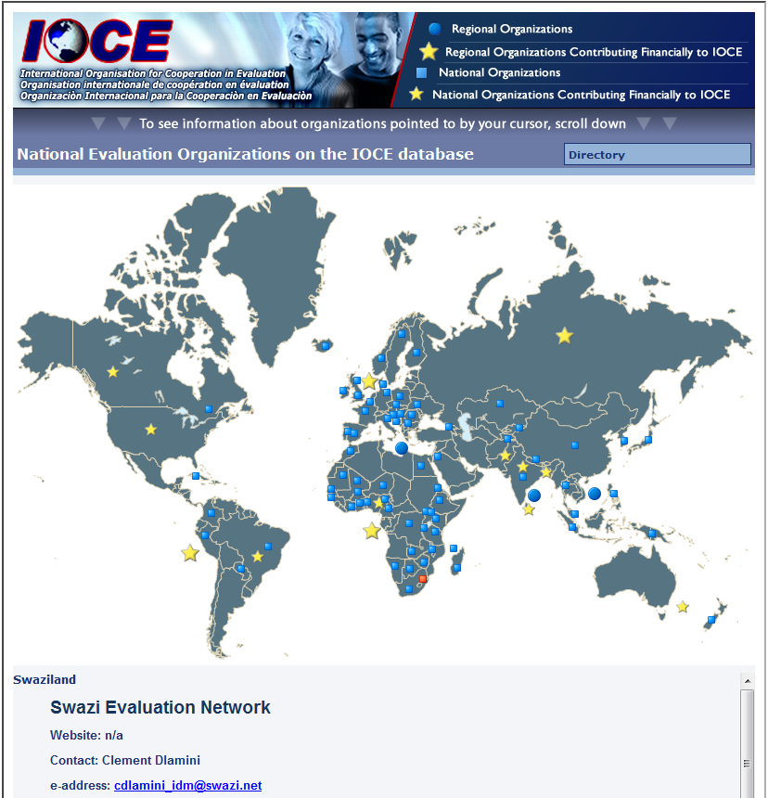

Slide 20
Mapping the status of VOPEs
See existing interactive world map and database of global VOPEs at
www.IOCE.net

Slide 21
That amazing growth of the evaluation profession is more succinctly summarized in the following bar graph …

Slide 22
Cumulative number of VOPEs in existence, by year (only including those reporting year of formation)

Slide 23
EvalPartners VOPE survey by the numbers
Countries in which we have some VOPE contact information: | 120
Number of national VOPEs heard of: | 151
Number of national VOPEs verified (survey responses and/or websites): | 103
Number of countries with verified VOPEs: | 91
Regional and international VOPEs: | 23
Total Verified VOPEs : | 127
Note: these numbers constantly change as new information is received. These numbers as of Sept. 2013.

Slide 24
Current membership numbers reported (including overlaps)(multiple memberships)
AEA (USA) | 7,550
ReLAC (Latin America & Caribbean) | 3,847
BMEN (Brazil) | 3,519
CES (Canada) | 2,016
AES (Australasia) | 1,034
DeGEval (Germany & Austria) | 722
All others reporting | 18,039
Total aggregate reported membership numbers: | 36,727

Slide 25
How formally organized are these VOPEs?
Types of organization (global data)
Informal networks | 39%
Charter & bylaws adopted | 13%
(but not officially recognized by govt.)
Legally recognized by government | 47%
(presumably charter & bylaws included)

Slide 26
How VOPEs are addressing “the evaluation environment” in their countries
An important component of the EvalPartners mapping survey has been to find out what VOPEs are doing to promote ECD in general, and governmental policies and the “demand side” for evaluation in particular.

Slide 27
How VOPEs are addressing “the evaluation environment” in their countries
A wide range of involvement in policy advocacy:
Policy advocacy score = 10 | 19 | 29%
Policy advocacy score between 5-9 | 14 | 21%
Policy advocacy score between 1-4 | 14 | 21%
Policy advocacy score = 0 | 19 | 29%
 | 66 | 100%

Slide 28

Peer-to-Peer (P2P) Program
+ Innovation Challenge grants
Multiple mutually beneficial partnerships being formed!

Slide 29

Here’s what some of these partnerships look like geo-graphically

Slide 30
Enabling Environment Taskforce
Toolkit to help VOPEs advocate for enhanced national evaluation policies and systems

Slide 31
Institutional Capacity Taskforce
Toolkit to help VOPEs strengthen their institutional capacities, including membership, governance, communications, finances

Slide 32
E-Learning Taskforce
Series of online webinars and courses based on the www.MyMandE.org
portal

Slide 33
E-Learning courses offered by 33 world-level experts
International experts, including Michael Quinn Patton, Michael Bamberger, Jim Rugh, David Fetterman, Patricia Rogers, Stewart Donaldson, Donna Mertens, Jennifer Greene, Bob Williams, Martin Reynolds, Saville Kushner and Hallie Preskill
Senior representatives of the international community, including Caroline Heider, Belen Sanz,
Indran Naidoo, Fred Carden, Hans Lundgren, and Marco Segone
Senior managers responsible for country-led M&E systems, including Sivagnanasothy Velayuthan and Diego Dorado
Leaders from the Global South and BRIC countries, including Zenda Ofir, Shiva Kumar and Alexey Kuzmin

Slide 34
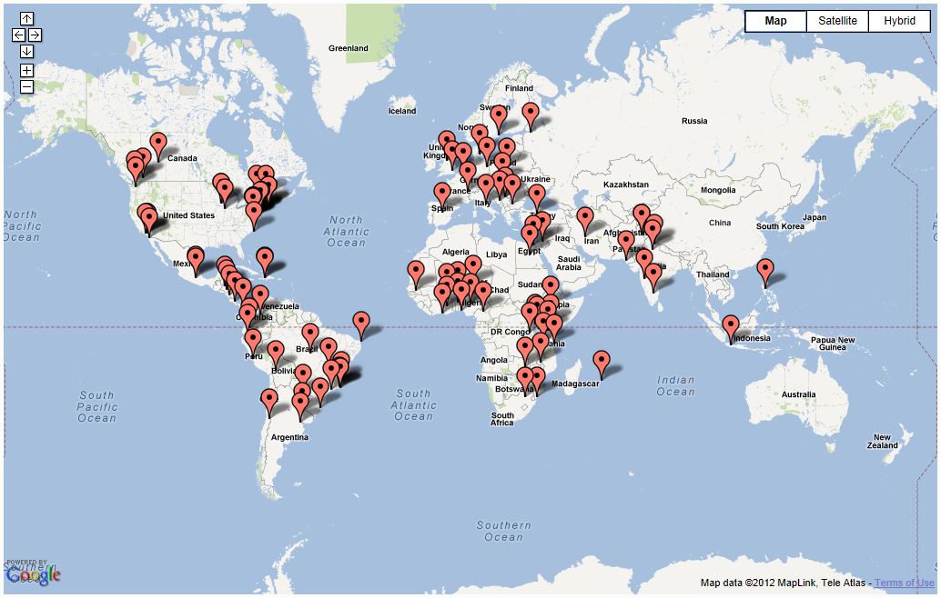
E-Learning Visitor Map

Slide 35


Books published

Slide 36
Equity-Focused and Gender-Responsive Taskforce
Promoting some of the underlying principles and over-all goals of EvalPartners

Slide 37
Early 2012 - EvalPartners Launch + mapping
December 2012 - International Forum of Civil Society Evaluation Capacity Building Strategies
2015 – The International Year of Evaluation
Sept-Oct. 2013 NEC conference with UNDP, Brazil

Slide 38
See updated current information about EvalPartners at:
www.MyMandE.org/EvalPartners

